Slide 1
Distributed Systems
Ali Kamandi, PH.D.
School of Engineering Sciences
College of Engineering
University of Tehran
kamandi@ut.ac.ir

Slide 2
Applications:
Distributed algorithms design: deadlock detection, replicated databases,…
Tracking of dependent events: distributed debugging, build a checkpoint in replicated databases.
Knowledge about the progress: garbage collection, termination detection
Concurrency measure: all events that are not causally related can be executed concurrently.

Slide 3
Need of Logical Clock
In real life, the global time is obtained from loosely synchronized clocks.
In distributed systems, the rate of occurrence of events is several magnitudes higher and the event execution time is several magnitudes smaller.
If the physical clocks are not precisely synchronized, the causality relation between events may not be accurately captured.
Network time Protocol, can maintain time accurate to a few tens of milliseconds on Internet, are not adequate to capture the causality relation in distributed systems.

Slide 4
Logical Clock
Each process has a logical clock that is advanced using a set of rules.
Every event is assigned a timestamp and the causality relation between events can be generally inferred from their timestamps.
Monotonicity property:
If an event a causally affects an event b, then the timestamp of a is smaller than timestamp of b.

Slide 5
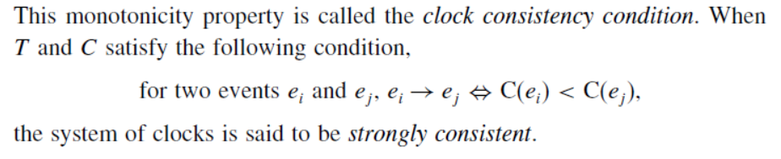
General Definition of Logical Clock
Logical clock C is a function that maps an event e to an element in the time domain T. C(e) called the timestamp of e.
C: H → T
Such that the following property is satisfied:

Slide 6
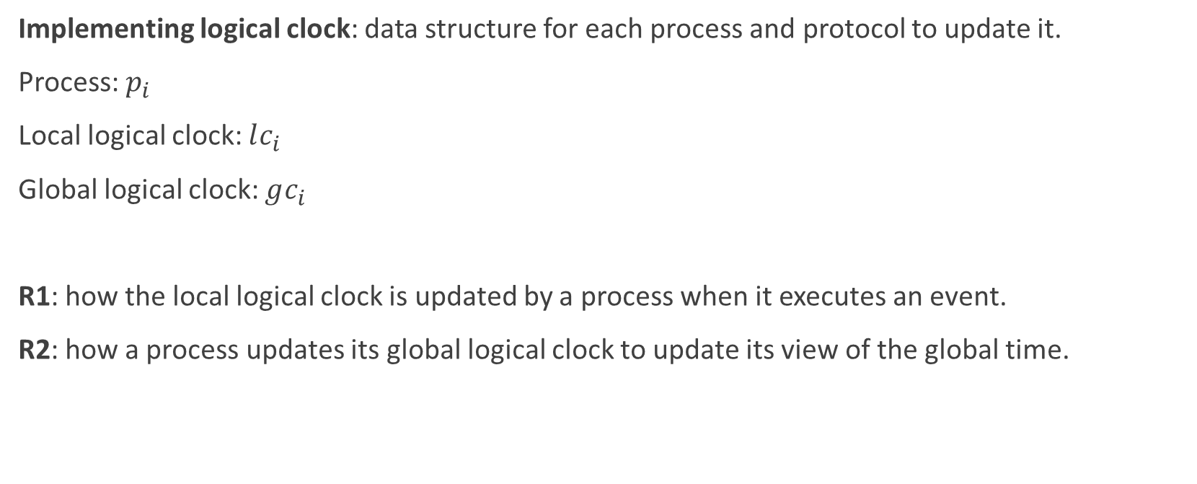
Implementing logical clock: data structure for each process and protocol to update it.
Process: $p_{i}$
Local logical clock: $lc_{i}$
Global logical clock: $gc_{i}$
R1: how the local logical clock is updated by a process when it executes an event.
R2: how a process updates its global logical clock to update its view of the global time.

Slide 7
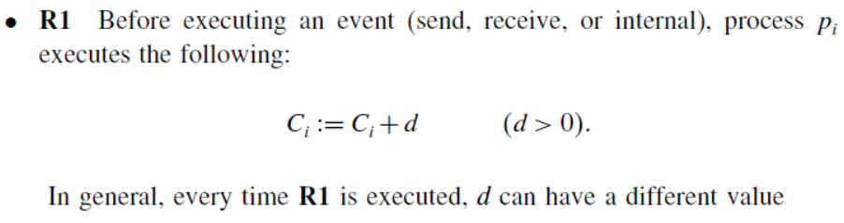
Scalar time: Lamport Clock (1978)
Time domain: set of non-negative integers.

Slide 8
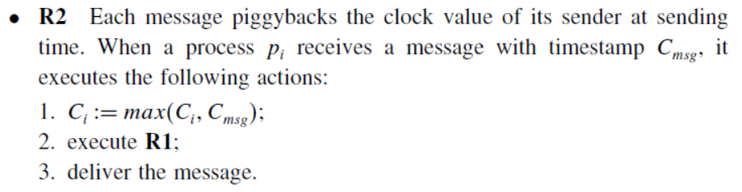
Scalar time: Lamport Clock (1978)

Slide 9
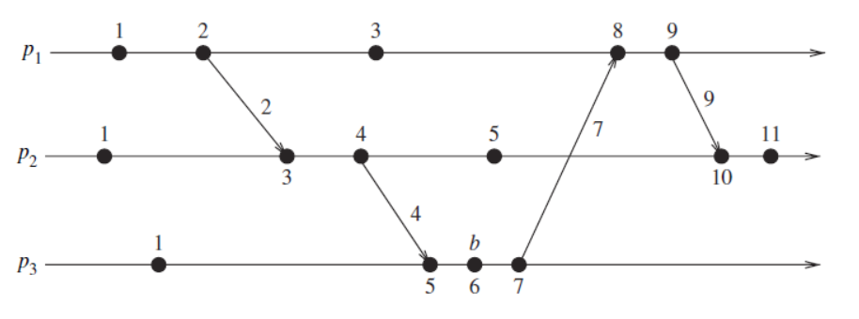
Scalar time: Lamport Clock (1978)

Slide 10
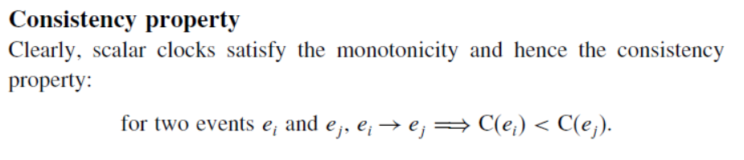
Consistency Property

Slide 11


Total ordering
Scalar clocks can be used to totally order events.
Two or more events at different processes may have an identical timestamp.
Timestamp of an event is denoted by a tuple (t,i), t is its time of occurrence and i is the identity of the process.
x: (h,i)
y: (k,j)

Slide 12
Event counting
If we set d to 1:
Timestamp h: h -1 is the minimum logical duration, height of the event h.
h – 1 events precede event e on the longest causal path ending at e.
h -1 events have been produced before e.

Slide 13

No Strong Consistency

Slide 14
Neiger-Toueg-Welch clock
Disadvantage of Lamport clock: huge jump.
Scheduled tasks: every 100 clock ticks.
Each process has its own clock and increments the clock whenever it feels like it.
Clock can be the physical clock.
(clock, id, eventCount)
eventCount: count of send/receive events.
This protocol cant change the clock value.
When a message is received with a timestamp later than the current extended clock value, its delivery is delayed until clock exceeds the message timestamp, at which point the receive event is assigned the extended clock value of the time of delivery.

Slide 15
Neiger-Toueg-Welch clock
If some process’s clock is too far off, it will have trouble getting its messages delivered quickly (if its clock is ahead) or receiving messages (if its clock is behind)—the net effect is to add a round-trip delay to that process equal to the difference between its clock and the clock of its correspondent. But the protocol works well when the processes’ clocks are closely synchronized,
which has become a plausible assumption in the last 10-15 years thanks to the Network Time Protocol, cheap GPS receivers, and clock synchronization mechanisms built into most cellular phone networks.

Slide 16
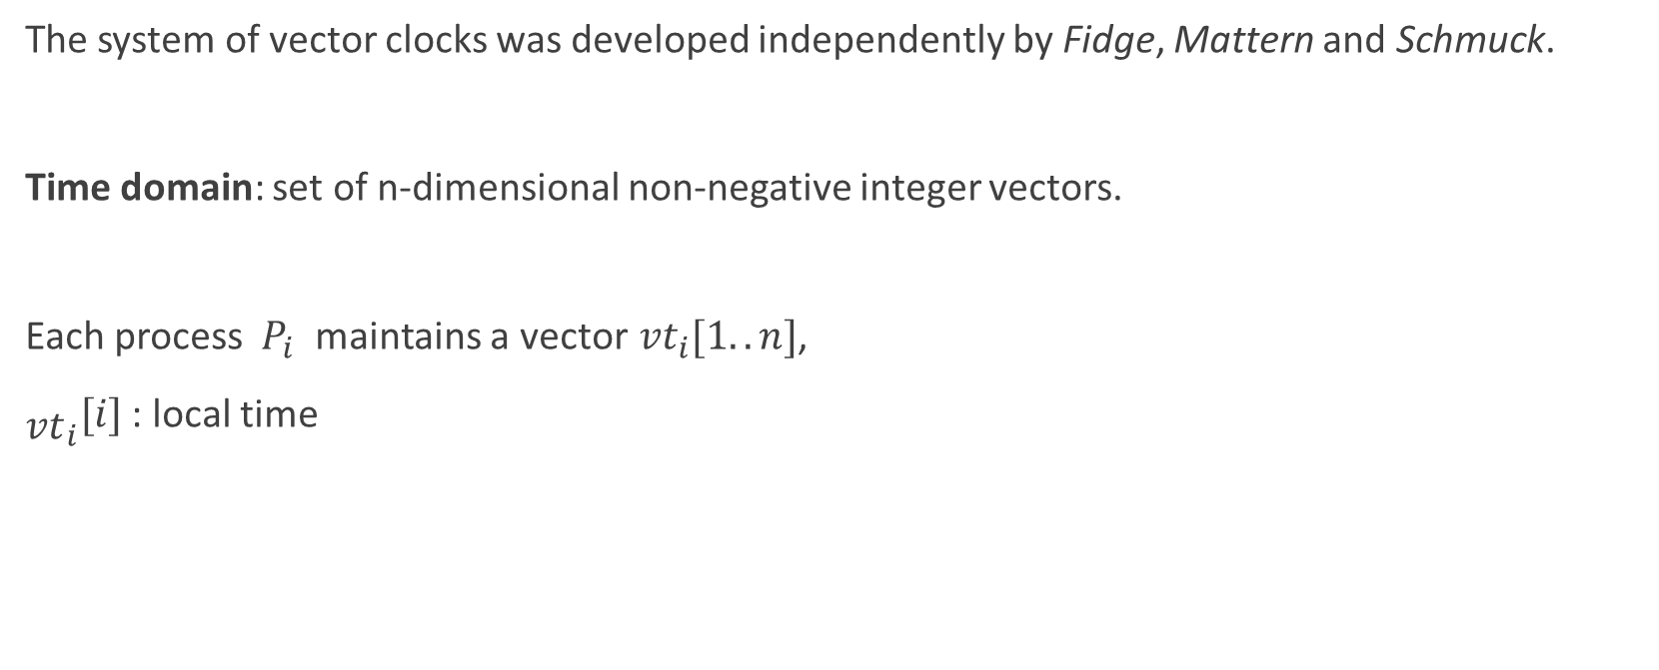
Vector Time
The system of vector clocks was developed independently by Fidge, Mattern and Schmuck.
Time domain: set of n-dimensional non-negative integer vectors.
Each process ${ P}_{i}$ maintains a vector${ vt}_{i}[1..n]$,
${\begin{aligned} \\ vt\end{aligned}}_{i}[i]$ : local time

Slide 17
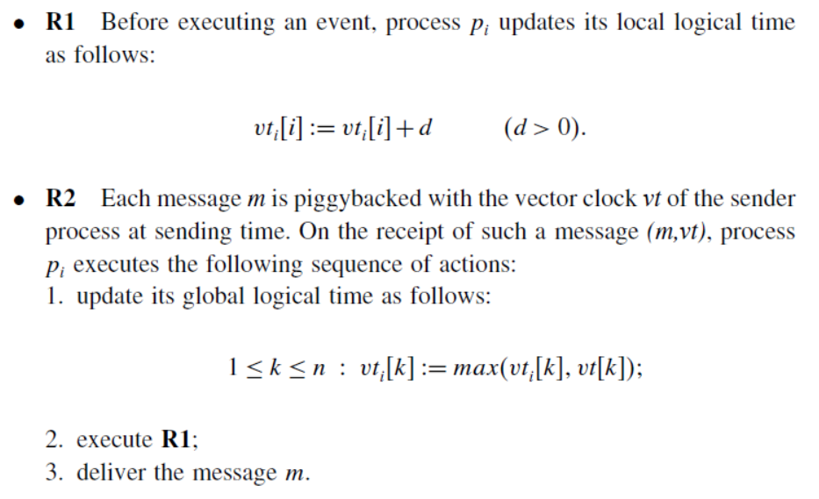

Slide 18
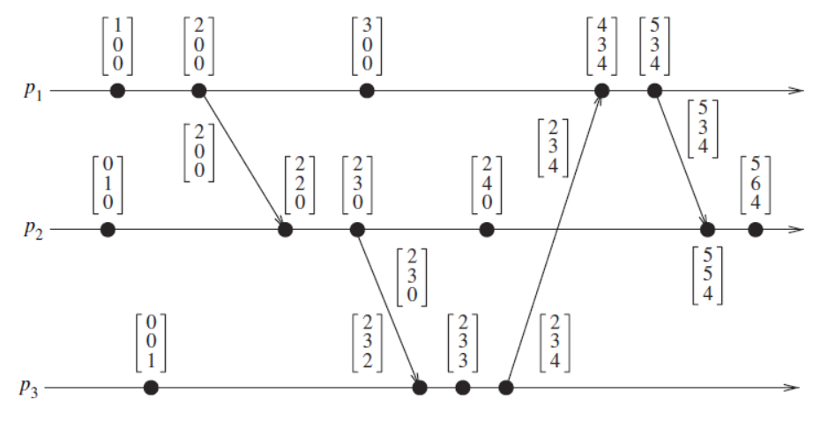

Slide 19
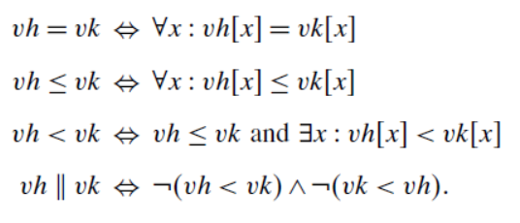

Slide 20
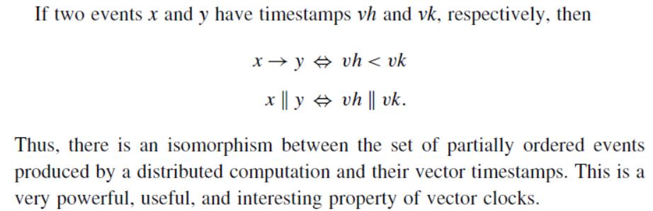
Isomorphism

Slide 21
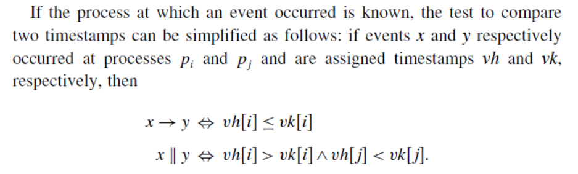

Slide 22
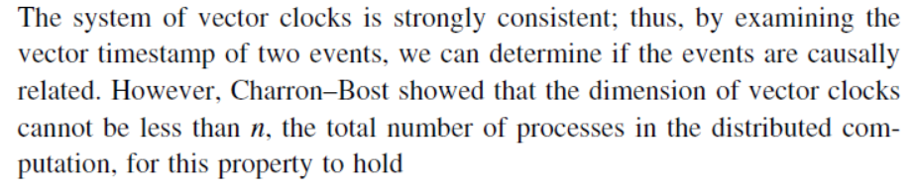
Strong consistency

Slide 23
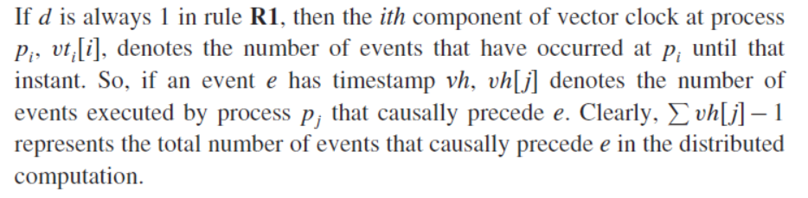
Event Counting

Slide 24
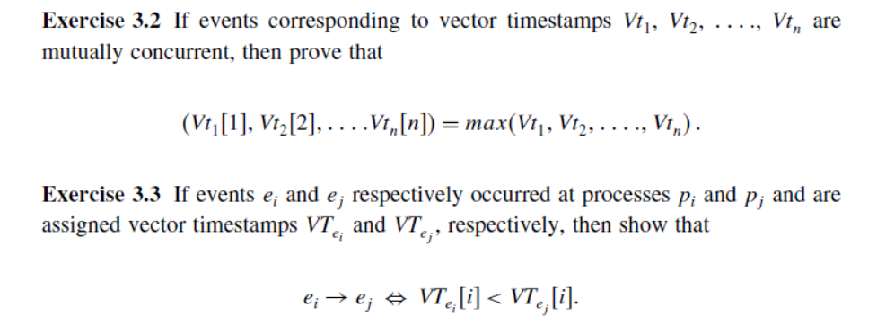
Exercises
1- Show that the dimension of vector clocks cannot be less than n, the total number of processes, for the strong consistency property to hold.
2- Research about network time protocol (NTP) and write two page report.

Slide 25
References
Singhal, Chapter 3.
Aspnes, Chapter 7

